Slide 1

Support Vector Machines
Notes:
‹#›

Slide 2
Objectives
What are support vector machines (SVM)?
How does SVM work?
When to use SVM?

Slide 3

What is SVM?
Supervised machine learning algorithm.
Ideally used for linearly separable data and is a lot like perceptron.
Objective: maximize the distance between the samples and boundaries.

Slide 4
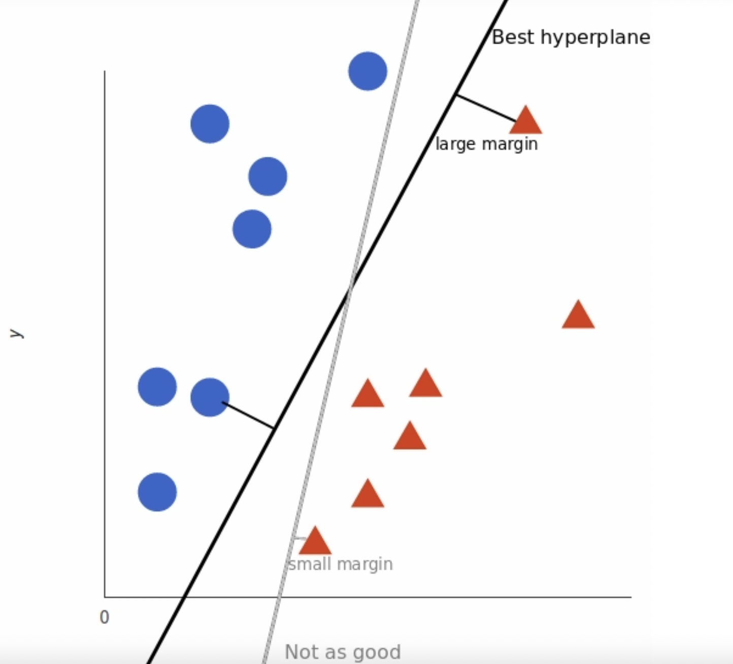

How Does SVM Work?
Basic idea: the algorithm creates a hyperplane that separates the data into classes.
The hyperplane is known as the decision boundary: anything that falls on one side of the hyperplane is classified as one class while data on the other side of the hyperplane is classified as another class.
The SVM algorithm prioritizes finding the best hyperplane by identifying the hyperplane that maximizes the margins from the tags.

Slide 5
When to Use SVM?
When provided a labeled dataset, the SVM machine learning algorithm can be used as it operates on labeled data.
SVM is more effective to use over other algorithms when the number of features is greater than the number of samples in the dataset.
You may use all of the supervised machine learning algorithms covered so far on a labeled dataset and identify which algorithm works the best on the dataset by comparing their performance after execution.

